Slide 1
Choice

Slide 2

Choice functions
Here, we start modeling "agent behavior"

Slide 3








Choice functions
Where should I do my PhD in computer science?

Slide 4
Choice functions
Consider a grand set X of possible alternatives
We view a choice problem as a nonempty subset of X, and we refer to a choice from A ⊆ X as specifying one of A’s members

Slide 5
Choice functions
A rational agent considers only the set of alternatives available to him
if the alternatives appear in a list, he ignores:
the order in which they are presented
the number of times an alternative appears in the list
an alternative with a default status
Notes:
Modeling a choice scenario as a set of alternatives implies assumptions of rationality according to which the agent’s choice does not depend on the way the alternatives are presented.

Slide 6
Choice functions
X = the set of all CS graduate programs in the world

Slide 7
Choice functions
X = the set of all CS graduate programs in the world

Slide 8
Choice functions
A = the set containing the items I can choose

Slide 9
Choice functions
A choice function C assigns to each set A a unique element of A with the interpretation that C(A) is the chosen element from the set A

Slide 10
Choice functions
C chooses the most difficult program to be admitted

Slide 11
Choice functions
C chooses the most difficult program to be admitted
C(A)

Slide 12
Choice functions
C chooses the program that is the closest to home
C(A)

Slide 13
Choice functions
C chooses the program that is located in the most fun city to live
C(A)

Slide 14
Choice functions
Where did you go for lunch today?
Is this your favorite restaurant in the world?
How can you model your choice function?

Slide 15
Choice functions
In some contexts, not all choice problems are relevant
Therefore we allow that the agent’s behavior be defined only on a set D of subsets of X
We will refer to a pair (X,D) as a context
Where should we go for lunch?
D can be thought of all the subsets of restaurants that are within walking distance from a given coordinate

Slide 16
Choice functions
Agent’s behavior as response to a questionnaire that contains questions of the following type, one for each A ∈ D:
Q(A): Assume you must choose from a set of alternatives A. Which alternative do you choose?
A permissible response to this questionnaire requires that the agent select a unique element in A for every question Q(A)
We implicitly assume that the agent cannot give any other answer such as “I choose either a or b”; “the probability of my choosing a ∈ A is p(a)”; or “I don’t know”

Slide 17
Rational choice functions
Choice is an outcome of “rational deliberation”
The decision maker has in mind a preference relation ≿ on the set X
Given any choice problem A in D, he chooses an element in A that is ≿optimal

Slide 18
Rational choice functions
The induced choice function C≿ assigns to every nonempty set A ∈ D the ≿-best element of A
Note that the preference relation is fixed, that is, it is independent of the choice set being considered

Slide 19
Rationalizing
The decision maker’s behavior can be described as if he is maximizing some preference relation
A choice function C can be rationalized if there is a preference relation ≿ on X so that C = C≿
C(A) = C≿(A) for any A in the domain of C
Always choose the ≿-best element in A

Slide 20
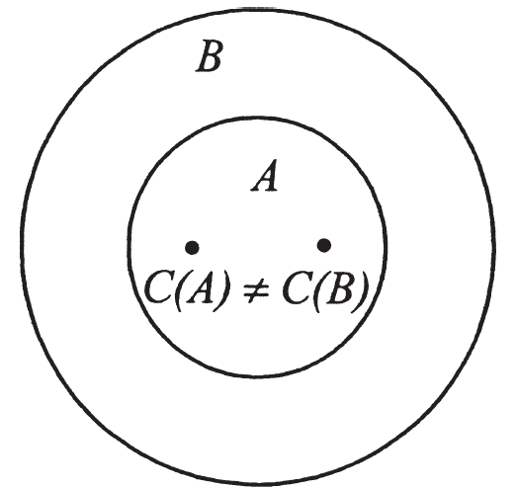
Rationalizing
Condition α:
We say that C satisfies condition α if for any two problems A,B ∈ D, if A ⊂ B and C(B) ∈ A, then…
C(A) = C(B)
Violates condition α!

Slide 21
Rationalizing
Example of a choice procedure that does not satisfy condition α?
The second-best procedure
the decision maker has in mind an ordering ≿ of X and for any given choice problem set A chooses the ≿-maximal from the non-optimal alternatives
If A contains all the elements in B besides the ≿-best, then C(B) ∈ A ⊂ B but C(A) ≠ C(B)

Slide 22
Rationalizing
Condition α is a sufficient condition for a choice function to be formulated as if the decision maker is maximizing some preference relation

Slide 23
Rationalizing
Proposition:
Assume that C is a choice function with a domain containing at least all subsets of X of size 2 or 3. If C satisfies condition α, then there is a preference ≿ on X so that C = C≿

Slide 24
Rationalizing
Proposition:
Assume that C is a choice function with a domain containing at least all subsets of X of size 2 or 3. If C satisfies condition α, then there is a preference ≿ on X so that C = C≿
Proof:
Define ≿ by x ≿ y if x = C({x, y})
Is the relation ≿ a preference relation?
Completeness: C({x, y}) is always well defined
Transitivity: If x ≿ y and y ≿ z, C({x, y}) = x and C({y, z}) = y. If C({x, z}) ≠ x, C({x, z}) = z. By condition α and C({x, z}) = z , C({x, y, z}) ≠ x. By condition α and C({x, y}) = x, C({x, y, z}) ≠ y, and by condition α and C({y, z}) = y, C({x, y, z}) ≠ z. A contradiction to C({x, y, z}) ∈ {x, y, z}
Is C(B) = C≿(B)?
Assume that C(B) = x and C≿(B) ≠ x, ie. there is y ∈ B so that y ≻ x
By definition of ≿, this means C({x, y}) = y, contradicting condition α

Slide 25
Rationalizing
Proposition:
Let C be a choice function with a domain D satisfying that if A,B ∈ D, then A ∪ B ∈ D
If C satisfies condition α, then there is a preference relation ≿ on X such that C = C≿
Proof:
in the book

Slide 26
Rationalizing
Condition α is a sufficient condition for a choice function to be formulated as if the decision maker is maximizing some preference relation
The agent will always select the ≿-best element available

Slide 27
Dutch Book Arguments
Claim:
An economic agent who behaves according to a choice function that is not induced from maximization of a preference relation will not survive
People should be rational in this sense and, if they are not, they should convert to reasoning of this type

Slide 28




Example
A monkey should pick a tree out of three to sleep in
Assume that the monkey can assess only two alternatives at a time and that his choice function is C({a, b}) = b, C({b, c}) = c, C({a, c}) = a
a
b
c
?

Slide 29
Example
A monkey should pick a tree out of three to sleep in
Assume that the monkey can assess only two alternatives at a time and that his choice function is C({a, b}) = b, C({b, c}) = c, C({a, c}) = a
This choice function can be derived from a preference relation?
a
b
c
?

Slide 30
Example
A monkey should pick a tree out of three to sleep in
Assume that the monkey can assess only two alternatives at a time and that his choice function is C({a, b}) = b, C({b, c}) = c, C({a, c}) = a
C({a,b}) = b
a
b
c

Slide 31
Example
A monkey should pick a tree out of three to sleep in
Assume that the monkey can assess only two alternatives at a time and that his choice function is C({a, b}) = b, C({b, c}) = c, C({a, c}) = a
C({b,c}) = c
a
b
c

Slide 32
Example
A monkey should pick a tree out of three to sleep in
Assume that the monkey can assess only two alternatives at a time and that his choice function is C({a, b}) = b, C({b, c}) = c, C({a, c}) = a
C({a,c}) = a
a
b
c

Slide 33
Example
A monkey should pick a tree out of three to sleep in
Assume that the monkey can assess only two alternatives at a time and that his choice function is C({a, b}) = b, C({b, c}) = c, C({a, c}) = a
Never sleeps! :(
a
b
c

Slide 34
Dutch book argument
What if a person X behaves like this monkey in a market towards three alternatives A, B and C?
"Money pump argument": an agent can offer B to X for A+ε, later C for B+ε, then A for C+ε, until X has no money

Slide 35

Alert!
Be careful with the alternatives' description!

Slide 36

What is an alternative
Suppose the following
Smith chooses chicken from the menu:
steak tartare, chicken
Smith chooses steak tartare from the menu:
steak tartare, chicken, frog legs
Is Smith rational?

Slide 37

What is an alternative
Now suppose the following
Smith chooses chicken from the menu:
steak tartare in a restaurant where frog legs are not served, chicken
Smith chooses steak tartare in a restaurant where frog legs are served from the menu:
steak tartare in a restaurant where frog legs are served, chicken, frog legs
Is Smith rational?

Slide 38

Choice Functions as Internal Equilibria
What is your favourite movie?

Slide 39
Choice Functions as Internal Equilibria
If the decision maker follows the rational man procedure using a preference relation with indifferences, the previously defined induced choice function C≿(A) might be undefined
For some choice problems there would be more than one optimal element

Slide 40
Choice Functions as Internal Equilibria
A choice correspondence C is required to assign to every nonempty A ∈ D a nonempty subset of A, that is, ∅ ≠ C(A) ⊆ A
C(A) is the set of all elements in A that are satisfactory
If the decision maker is about to make a decision and choose a ∈ C(A), he has no desire to move away from it

Slide 41
Choice Functions as Internal Equilibria
In other words, the induced choice correspondence reflects an “internal equilibrium”:
If the decision maker facing A considers an alternative outside C(A), he will continue searching for another alternative
If he happens to consider an alternative inside C(A), he will take it

Slide 42
Choice Functions as Internal Equilibria
Given a preference relation ≿ we define the induced choice correspondence (assuming it is never empty) as
C≿(A) = {x ∈ A | x ≿ y for all y ∈ A}
When x, y ∈ A and x ∈ C(A), we say that x is revealed to be at least as good as y
If, in addition, y ∉ C(A), we say that x is revealed to be strictly better than y

Slide 43
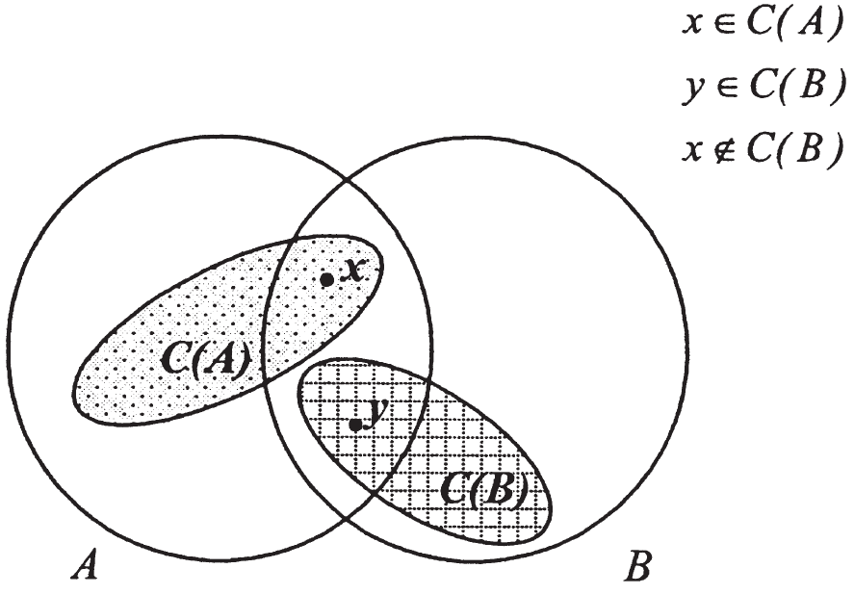
Choice Functions as Internal Equilibria
The Weak Axiom of Revealed Preference (WA):
We say that C satisfies WA if whenever x, y ∈ A ∩ B, x ∈ C(A), and y ∈ C(B), it is also true that x ∈ C(B)
Violates WA!

Slide 44
Choice Functions as Internal Equilibria
The Weak Axiom trivially implies two properties:
Condition α: If a ∈ A ⊂ B and a ∈ C(B), then
a ∈ C(A)
Condition β: If a, b ∈ A ⊂ B, a ∈ C(A), and b ∈ C(B), then
a ∈ C(B) and b ∈ C(A)
Notice that if C(A) contains all elements that are maximal according to some preference relation, then C satisfies WA

Slide 45

The Satisfying Procedure
How do you proceed when you have to buy a laptop?

Slide 46
The Satisfying Procedure
You need to buy a laptop which has
at least 256 Gb of SSD,
at least 8 Gb of RAM,
dedicated graphics processor,
and weights at most 2.0 Kg
How do you proceed in this case?

Slide 47
The Satisfying Procedure
Consider the following “decision scheme”
Let v : X → ℝ be a valuation of the elements in X
Let v∗ ∈ ℝ be a threshold of satisfaction
Let O be an ordering of the alternatives in X
e.g. price
Given a set A, the decision maker arranges the elements of this set in a list L(A,O) according to the ordering O
He then chooses the first element in L(A,O) that has a v-value at least as large as v∗
If there is no such element in A, the decision maker chooses the last element in L(A,O)

Slide 48
The Satisfying Procedure
Reminder:
Condition α: we say that C satisfies condition α if for any two problems A,B ∈ D, if A ⊂ B and C(B) ∈ A, then C(A) = C(B)
Does the choice function induced by this procedure satisfy condition α?
YES!

Slide 49
The Satisfying Procedure
Assume that a is chosen from B and is also a member of A ⊂ B
The list L(A,O) is obtained from L(B,O) by eliminating all elements in B − A
If v(a) ≥ v∗, then a is the first satisfactory element in L(B,O) and is also the first satisfactory element in L(A,O)
Thus, a is chosen from A
If all elements in B are unsatisfactory, then a must be the last element in L(B,O)
Since A is a subset of B, all elements in A are unsatisfactory and a is the last element in L(A,O)
Thus, a is chosen from A

Slide 50
The Satisfying Procedure
Summary
The satisfying procedure, proposed by Herbert Simon, though it is stated in a way that seems unrelated to the maximization of a preference relation or utility function, can be described as if the decision maker maximizes a preference relation

Slide 51
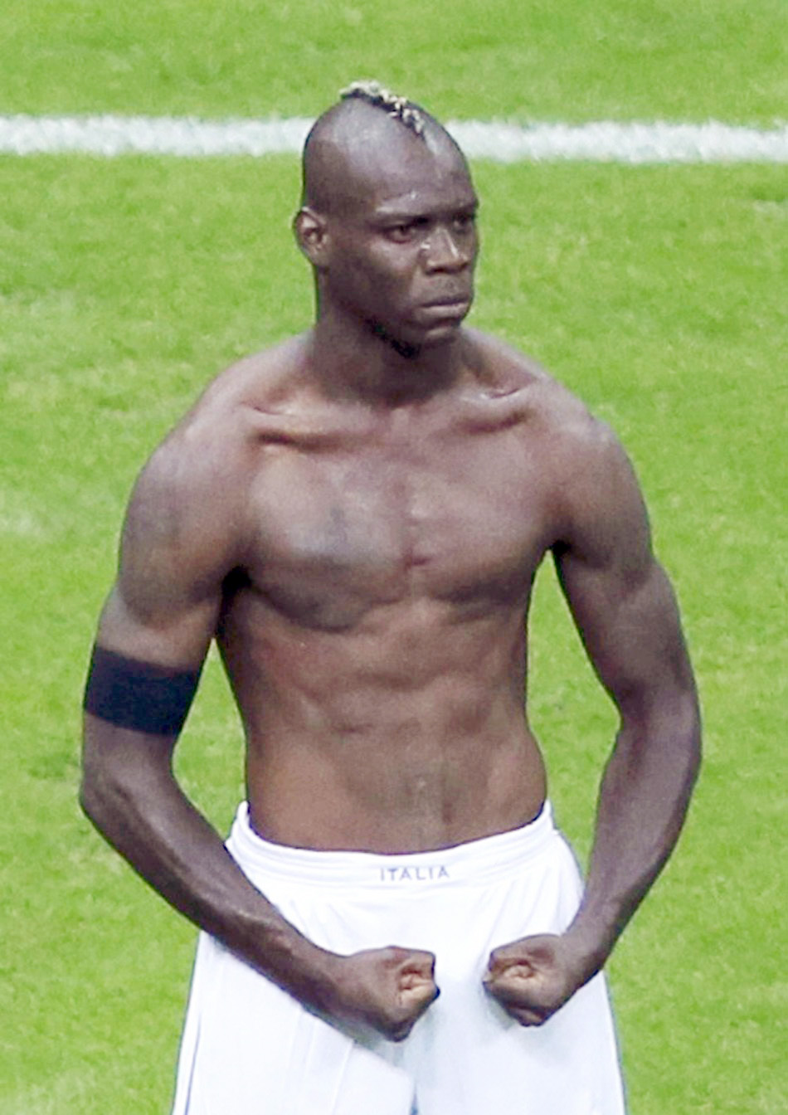

Choice Functions as Internal Equilibria
Who would you pick to be your teammate?
Notes:
Mario Balotelli vs. Robert Lewandowski

Slide 52
Choice Functions as Internal Equilibria
C(A) may be chosen under any of many possible particular circumstances not included in the description of the set A
Formally, let (A, f) be an extended choice set where f is the frame that accompanies the set A
e.g.: the default alternative or the order of the alternatives
Let c(A, f) be the choice of the decision maker from the choice set A given the frame f

Slide 53
Choice Functions as Internal Equilibria
The (extended) choice function c induces a choice correspondence by
C(A) = {x|x = c(A, f) for some f}

Slide 54
Psychological Motives Not Included within the Framework
Framing
Simplifying the choice problem and the use of similarities
Reason-based choice
Mental accounting

Slide 55
Framing
An outbreak of disease is expected to cause 600 deaths in the United States
Two mutually exclusive programs are expected to yield the following results:
a. Exactly 400 people will die
b. With probability 1/3, 0 people will die, and with probability 2/3, 600 people will die
Which program would you choose?

Slide 56
Framing
In essence, framing theory suggests that how something is presented to the audience (called “the frame”) influences the choices people make about how to process that information

Slide 57
Framing
An outbreak of disease is expected to cause 600 deaths in the United States
Two mutually exclusive programs are expected to yield the following results:
A. Exactly 200 people will be saved
B. With probability 1/3, all 600 will be saved, and with probability 2/3, none will be saved
Which program would you choose?

Slide 58
Framing
Results in our class
a. 400 people will die
b. With probability 1/3, 0 people will die, and with probability 2/3, 600 people will die
20% chose a (1/5)
A. 200 people will be saved
B. With probability 1/3, all 600 will be saved, and with probability 2/3, none will be saved
86% chose A (6/7)

Slide 59
Framing
Results in 2024/01
a. 400 people will die
b. With probability 1/3, 0 people will die, and with probability 2/3, 600 people will die
43% chose a (3/7)
A. 200 people will be saved
B. With probability 1/3, all 600 will be saved, and with probability 2/3, none will be saved
83% chose A (5/6)

Slide 60
Framing
Results in 2022/01
a. 400 people will die
b. With probability 1/3, 0 people will die, and with probability 2/3, 600 people will die
50% chose a (4/8)
A. 200 people will be saved
B. With probability 1/3, all 600 will be saved, and with probability 2/3, none will be saved
75% chose A (6/8)

Slide 61
Framing
Results in 2019/02
a. 400 people will die
b. With probability 1/3, 0 people will die, and with probability 2/3, 600 people will die
30% chose a (11/37)
A. 200 people will be saved
B. With probability 1/3, all 600 will be saved, and with probability 2/3, none will be saved
48% chose A (14/29)

Slide 62
Framing
Results in 2017/02
a. 400 people will die
b. With probability 1/3, 0 people will die, and with probability 2/3, 600 people will die
19% chose a (5/26)
A. 200 people will be saved
B. With probability 1/3, all 600 will be saved, and with probability 2/3, none will be saved
59% chose A (10/17)

Slide 63
Framing
Results in 2016/02
a. 400 people will die
b. With probability 1/3, 0 people will die, and with probability 2/3, 600 people will die
22% chose a
A. 200 people will be saved
B. With probability 1/3, all 600 will be saved, and with probability 2/3, none will be saved
56% chose A

Slide 64
Framing
Results in 2015-2
a. 400 people will die
b. With probability 1/3, 0 people will die, and with probability 2/3, 600 people will die
27% chose a
A. 200 people will be saved
B. With probability 1/3, all 600 will be saved, and with probability 2/3, none will be saved
57% chose A

Slide 65
Framing
Experiment conducted by Tversky and Kahneman (1986)
Whereas only 22% of the first group chose a, 72% of the second group chose A
These are “problematic” results since by any reasonable criterion a and A are identical alternatives, as are b and B
Thus, the choice from {a, b} should be consistent with the choice from {b, B}

Slide 66
Framing
Overall, the results expose the sensitivity of choice to the framing of the alternatives
What is more basic to rational decision making than taking the same choice when only the manner in which the problems are stated is different?

Slide 67
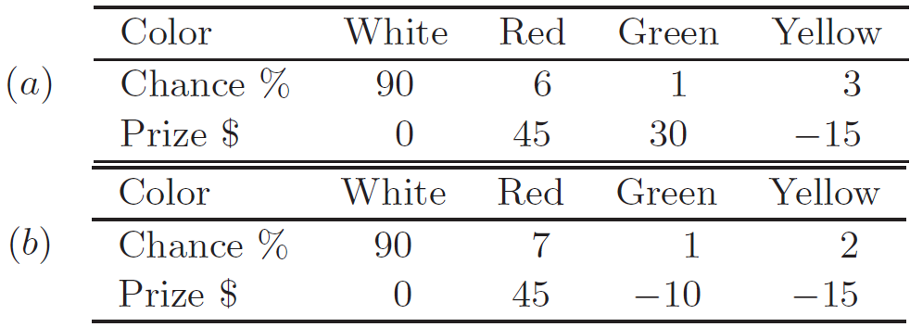
Simplifying the Choice Problem and the Use of Similarities
Which roulette do you prefer, a or b?

Slide 68
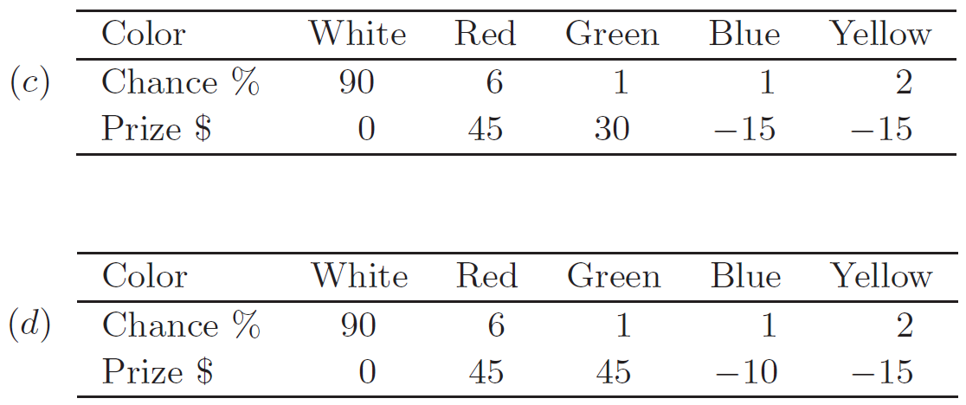
Simplifying the Choice Problem and the Use of Similarities
Which roulette do you prefer, a or b?

Slide 69
Results for our class
Which roulette do you prefer, a or b?
0% of the students chose a (0/3)

Slide 70
Results for our class
Which roulette do you prefer, c or d?
0% of the students chose c (0/9)

Slide 71
Results for 2024/01
Which roulette do you prefer, a or b?
29% of the students chose a (2/7)

Slide 72
Results for 2024/01
Which roulette do you prefer, c or d?
0% of the students chose c (0/6)

Slide 73
Results for 2022/01
Which roulette do you prefer, a or b?
44% of the students chose a (4/9)

Slide 74
Results for 2022/01
Which roulette do you prefer, c or d?
0% of the students chose c (0/9)

Slide 75
Results in 2019/02
Which roulette do you prefer, a or b?
42% of the students chose a (13/31)

Slide 76
Results in 2019/02
Which roulette do you prefer, c or d?
9% of the students chose c (3/33)

Slide 77
Results in 2017/2
Which roulette do you prefer, a or b?
30% of the students chose a (7/23)

Slide 78
Results in 2017/2
Which roulette do you prefer, c or d?
0% of the students chose c (0/20)

Slide 79
Results in 2016/2
Which roulette do you prefer, a or b?
55% of the students chose a

Slide 80
Results in 2016/2
Which roulette do you prefer, c or d?
0% of the students chose c

Slide 81
Results for 2015-2
Which roulette do you prefer, a or b?
40% of the students chose a

Slide 82
Results for 2015-2
Which roulette do you prefer, c or d?
5% of the students chose c

Slide 83
Simplifying the Choice Problem and the Use of Similarities
Which roulette do you prefer, a or b?
Also in Tversky and Kahneman (1986)
58% of the subjects in the first group chose a
Nobody in the second group chose c
Students in A. Rubinstein class
two problems were presented, one after the other, to about 1,350 students
52% chose a
7% chose c

Slide 84
Simplifying the Choice Problem and the Use of Similarities
In a complicated choice problem, we often transfer the complicated problem into a simpler one by “canceling” similar elements
Although d clearly dominates c, the comparison between a and b is not as easy

Slide 85
Simplifying the Choice Problem and the Use of Similarities
Many subjects “cancel” the probabilities of White, Yellow, and Red and are left with comparing the prizes of Green, a process that leads them to choose a

Slide 86

Reason-Based Choice
Derp must choose between two universities

Slide 87

Reason-Based Choice
C({Stanford, UFMG}) = Stanford

Slide 88
Reason-Based Choice
Derp must choose between three universities

Slide 89
Reason-Based Choice
C({Stanford, CMU, UFMG}) = UFMG

Slide 90
Reason-Based Choice
Does his choice satisfy condition α?
No!
Is the reason related to a careless specification of the alternatives (as in the restaurant’s menu example discussed previously)?
No!

Slide 91
Reason-Based Choice
What happened, then?
His explanation is that he prefers an American university so long as he does not have to choose between American schools – a choice he deems harder
His reasoning involves an attempt to avoid the difficulty of making a decision

Slide 92
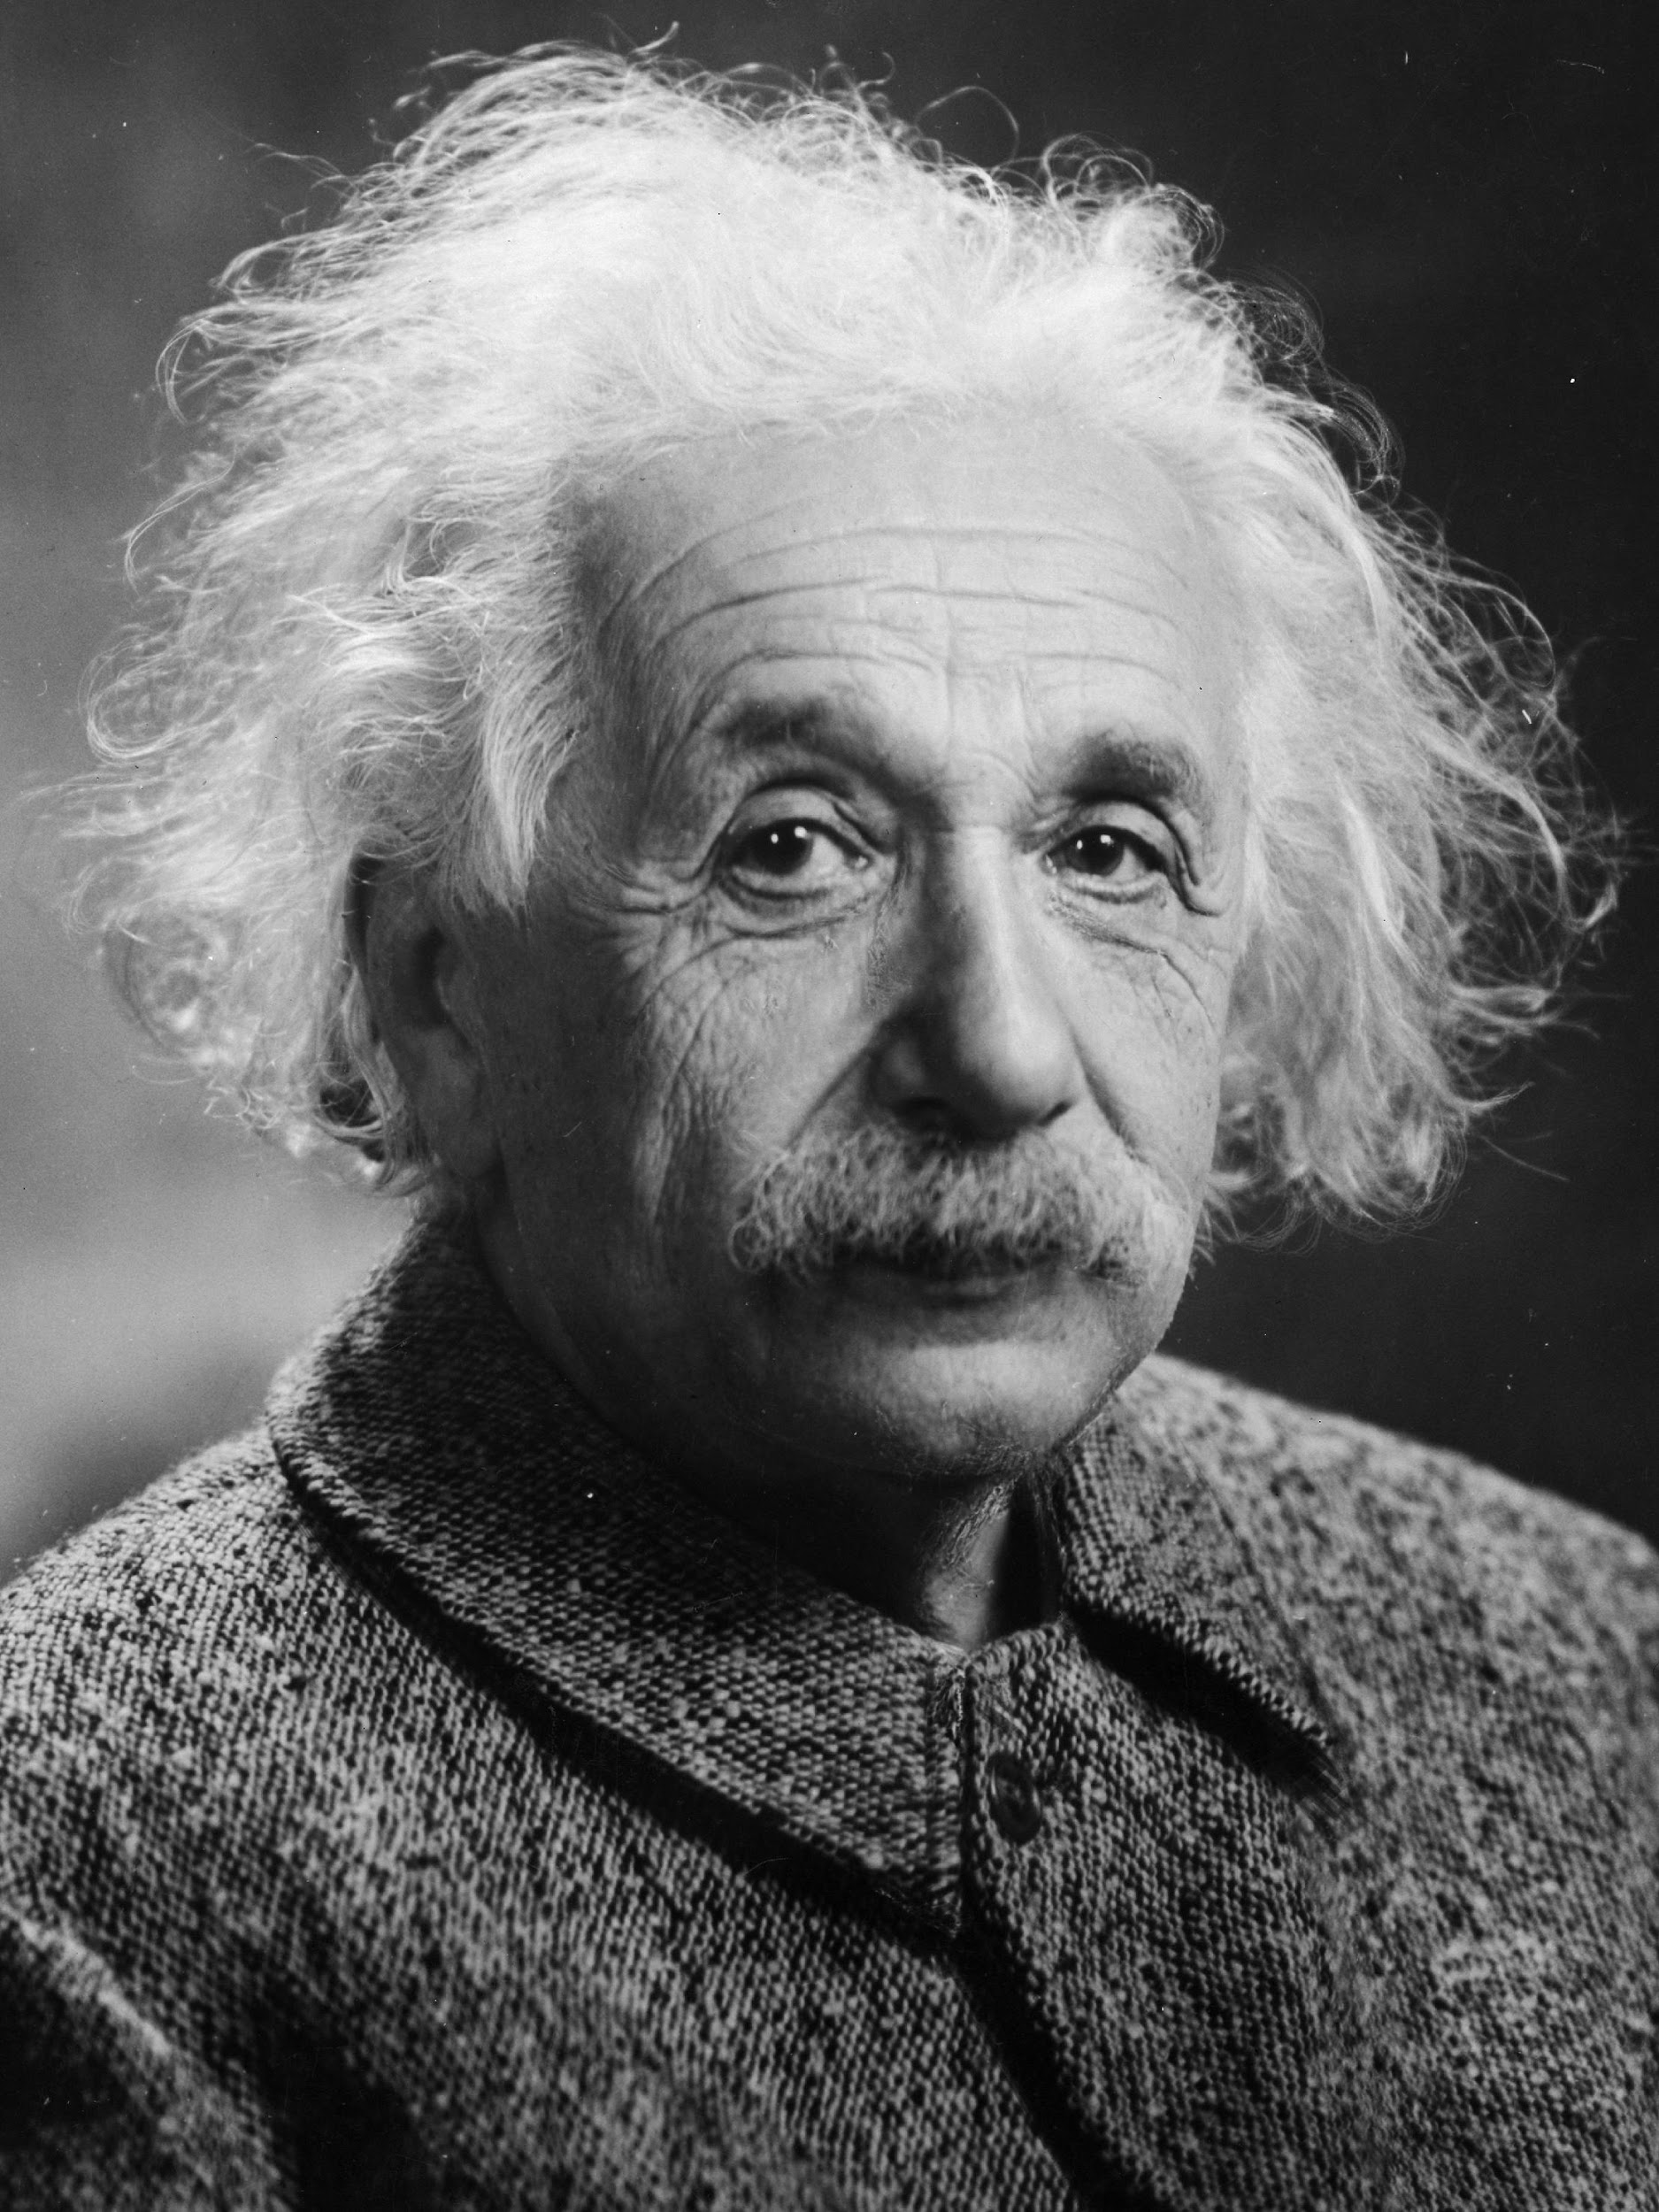
Reason-Based Choice
As another example, imagine a handsome guy called Albert, who is looking for a date to take to a party

Slide 93


Reason-Based Choice
Albert knows two girls that are crazy about him, both of whom would love to go to the party
The two girls are called Mary and Laura

Slide 94
Reason-Based Choice
Of the two, Albert prefers Mary

Slide 95

Reason-Based Choice
Now imagine that Mary has a sister, and this sister is also crazy about Albert

Slide 96
Reason-Based Choice
Which girl should Albert choose?
Is the reason related to a careless specification of the alternatives?

Slide 97
Reason-Based Choice
Another example follows Huber, Payne, and Puto (1982)
Let a = (a1, a2) be “a holiday package of a1 days in Paris and a2 days in London”
Choose one of the four vectors
a = (7, 4), b = (4, 7), c = (6, 3), and d = (3, 6)
All subjects in the experiment agreed that a day in Paris and a day in London are desirable goods

Slide 98
Reason-Based Choice
Choose one of the four vectors
a = (7, 4), b = (4, 7), c = (6, 3), and d = (3, 6)
Some had to choose between a, b, and c
Others had to choose between a, b, and d

Slide 99
Results for our class
Choose one of the three vectors
a = (7, 4), b = (4, 7) and c = (6, 3)
33% (2/6) chose (7,4)
67% (4/6) chose (4,7)
0% chose (6,3)

Slide 100
Results for our class
Choose one of the three vectors
a = (7, 4), b = (4, 7) and d = (3, 6)
20% (2/10) chose (7,4)
80% (8/10) chose (4,7)
0% chose (3,6)

Slide 101
Results for 2024/01
Choose one of the three vectors
a = (7, 4), b = (4, 7) and c = (6, 3)
43% chose (7,4)
57% chose (4,7)
0% chose (6,3)

Slide 102
Results for 2024/01
Choose one of the three vectors
a = (7, 4), b = (4, 7) and d = (3, 6)
50% chose (7,4)
50% chose (4,7)
0% chose (3,6)

Slide 103
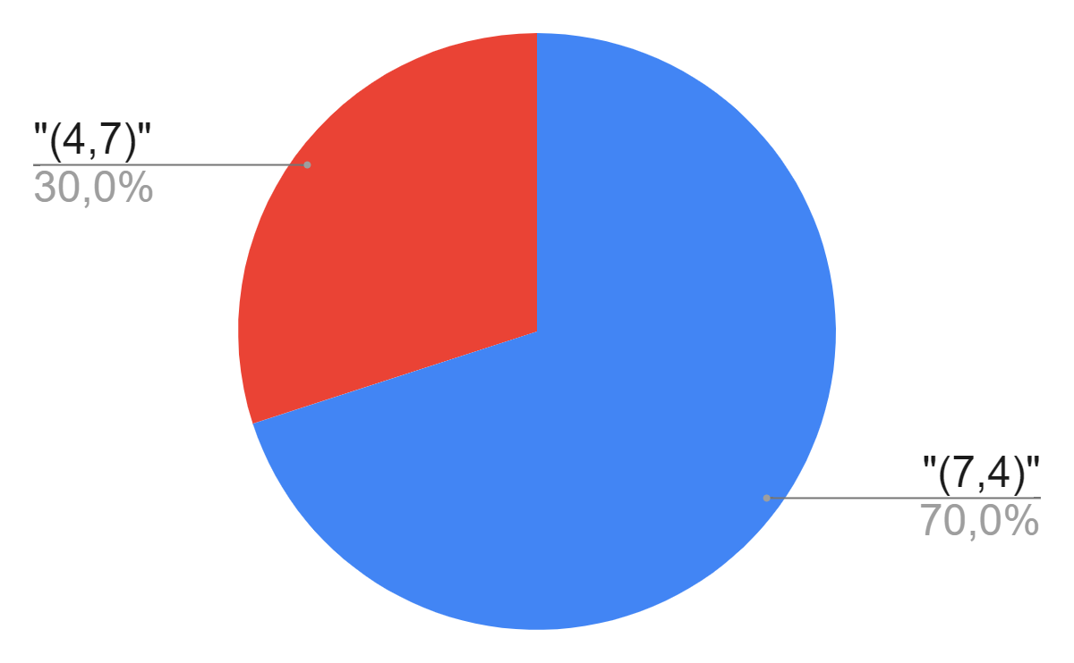
Results for 2022/01
Choose one of the three vectors
a = (7, 4), b = (4, 7) and c = (6, 3)

Slide 104
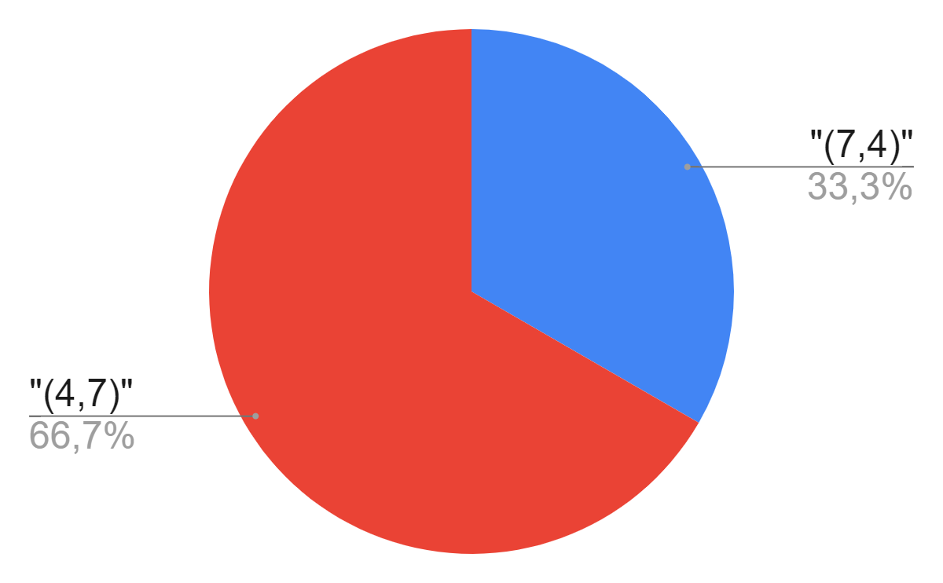
Results for 2022/01
Choose one of the three vectors
a = (7, 4), b = (4, 7) and d = (3, 6)

Slide 105
Reason-Based Choice
Choose one of the four vectors
a = (7, 4), b = (4, 7), c = (6, 3), and d = (3, 6)
Some had to choose between a, b, and c
Others had to choose between a, b, and d
Conclusion:
The subjects exhibited a clear tendency toward choosing a out of the set {a, b, c} and choosing b out of the set {a, b, d}

Slide 106
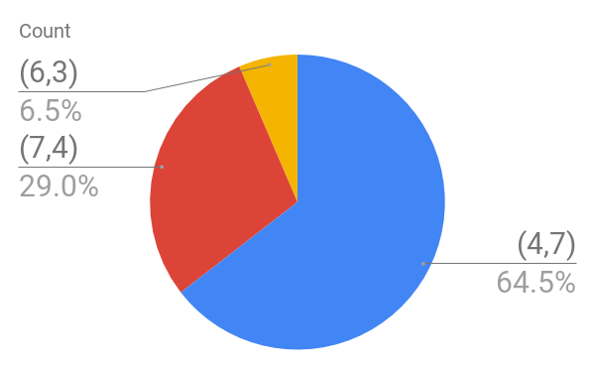
Results in 2019/02
Choose one of the three vectors
a = (7, 4), b = (4, 7) and c = (6, 3)

Slide 107
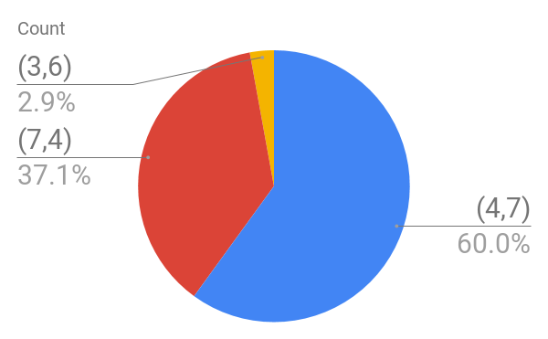
Results in 2019/02
Choose one of the three vectors
a = (7, 4), b = (4, 7) and d = (3, 6)

Slide 108


Slide 109
Reason-Based Choice
Decision makers look for reasons to prefer one alternative over the other
Typically, making decisions by using “external reasons” will not cause violations of rationality
However, applying “internal reasons” such as “I prefer the alternative a over the alternative b since a clearly dominates the other alternative c while b does not” might cause conflicts with condition α.

Slide 110
Reason-Based Choice
“This paper considers the role of reasons and arguments in the making of decisions. It is proposed that, when faced with the need to choose, decision makers often seek and construct reasons in order to resolve the conflict and justify their choice, to themselves and to others.”
Shafir, Eldar, Itamar Simonson, and Amos Tversky. "Reason-based choice." Cognition 49.1-2 (1993): 11-36.

Slide 111
Mental Accounting
From Kahneman and Tversky (1984)
Group 1
You have decided to see a play and paid the admission price of $10 per ticket. As you approach the theater, you discover that you have lost the ticket. The seat was not marked and the ticket cannot be recovered. Would you pay $10 for another ticket?
Group 2
You have decided to see a play where the admission is $10 per ticket. As you arrive at the theater, you discover that you have lost a $10 bill. Would you still pay $10 for a ticket for the play?

Slide 112
Mental Accounting
Group 1
You have decided to see a play and paid the admission price of $10 per ticket. As you approach the theater, you discover that you have lost the ticket. The seat was not marked and the ticket cannot be recovered. Would you pay $10 for another ticket?
Group 2
You have decided to see a play where the admission is $10 per ticket. As you arrive at the theater, you discover that you have lost a $10 bill. Would you still pay $10 for a ticket for the play?
Should you give different answers to these questions?

Slide 113
Mental Accounting
Should you give different answers to these questions?
If you care only about seeing the play and your wealth, then no
Nonetheless, only 46% said they would buy another ticket after they had lost the first one, whereas 88% said they would buy a ticket after losing the banknote
Many of those who decided not to buy another ticket after losing the first one attributed a price of $20 to the ticket rather than $10

Slide 114
Results for our class
Group 1
You have decided to see a play and paid the admission price of $10 per ticket. As you approach the theater, you discover that you have lost the ticket. The seat was not marked and the ticket cannot be recovered. Would you pay $10 for another ticket?
75% (6/8) chose yes
25% (2/8) chose no

Slide 115
Results for our class
Group 2
You have decided to see a play where the admission is $10 per ticket. As you arrive at the theater, you discover that you have lost a $10 bill. Would you still pay $10 for a ticket for the play?
87,50% (7/8) chose yes
12,50% (1/8) chose no

Slide 116
Results for 2024/01
Group 1
You have decided to see a play and paid the admission price of $10 per ticket. As you approach the theater, you discover that you have lost the ticket. The seat was not marked and the ticket cannot be recovered. Would you pay $10 for another ticket?
100% chose yes
0% chose no

Slide 117
Results for 2024/01
Group 2
You have decided to see a play where the admission is $10 per ticket. As you arrive at the theater, you discover that you have lost a $10 bill. Would you still pay $10 for a ticket for the play?
100% chose yes
0% chose no

Slide 118
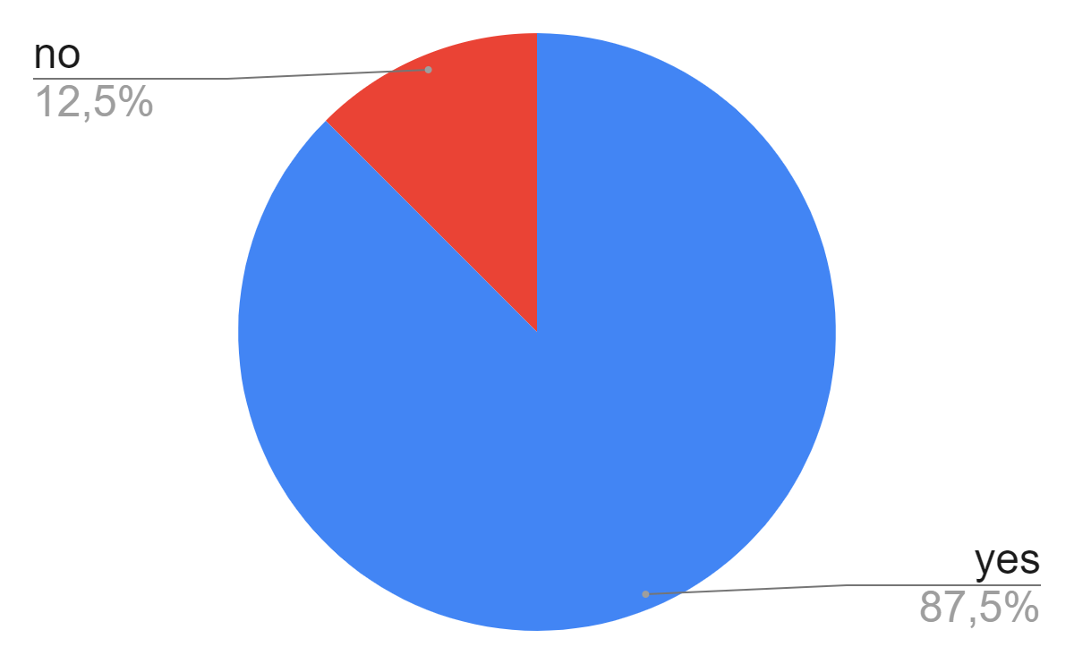
Results for 2022/01
Group 1
You have decided to see a play and paid the admission price of $10 per ticket. As you approach the theater, you discover that you have lost the ticket. The seat was not marked and the ticket cannot be recovered. Would you pay $10 for another ticket?

Slide 119
Results for 2022/01
Group 2
You have decided to see a play where the admission is $10 per ticket. As you arrive at the theater, you discover that you have lost a $10 bill. Would you still pay $10 for a ticket for the play?

Slide 120
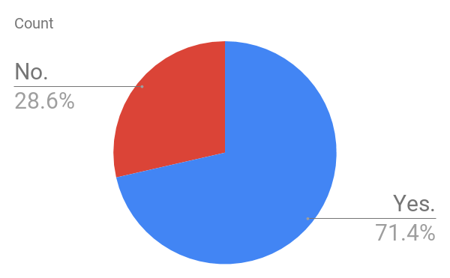
Results in 2019/02
Group 1
You have decided to see a play and paid the admission price of $10 per ticket. As you approach the theater, you discover that you have lost the ticket. The seat was not marked and the ticket cannot be recovered. Would you pay $10 for another ticket?

Slide 121
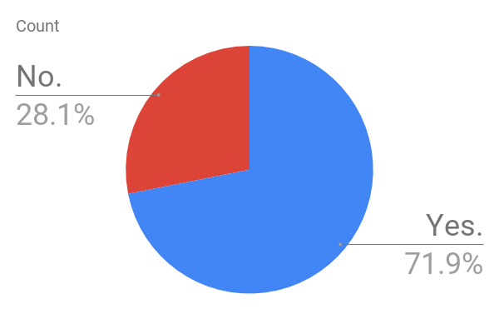
Results in 2019/02
Group 2
You have decided to see a play where the admission is $10 per ticket. As you arrive at the theater, you discover that you have lost a $10 bill. Would you still pay $10 for a ticket for the play?

Slide 123
Mental Accounting
This example demonstrates that decision makers may conduct “mental calculations” that are inconsistent with rationality

Slide 124
Modeling Choice Procedures
There is a large body of evidence showing that decision makers systematically use procedures of choice that violate the classical assumptions and that the rational man paradigm is lacking
More and more economic models in which economic agents are assumed to follow alternative procedures of choice

Slide 125
Modeling Choice Procedures
Now we will include not only the set of alternatives but additional information as well
This additional information is considered to be irrelevant to the interests of the decision maker but may nevertheless affect his choice

Slide 126
Modeling Choice Procedures
Another is a case in which the additional information consists of a default option

Slide 127
Modeling Choice Procedures
The statement c(A, a) = b means that when facing the choice problem A with a default alternative a the decision maker chooses the alternative b
Experimental evidence and introspection tell us that a default option is often viewed positively by decision makers
This phenomenon is known as the status quo bias

Slide 128
Modeling Choice Procedures
Any examples in the real life?
reelection?

Slide 129
Modeling Choice Procedures
Let X be a finite set of alternatives
Define an extended choice function to be a function that assigns a unique element in A to every pair (A, a) where A ⊆ X and a ∈ A
a can be any element of A
Let's see some examples...

Slide 130
Modeling Choice Procedures
The decision maker has in mind a vector of orderings (≻_{i}), which are interpreted to be criteria, and an additional ordering ≻ interpreted to be the real preference relation of the decision maker
The alternative C(A, a) is the ≻-best element in the set of alternatives which are as good as a by all criteria
C(A, a) = {x| x ≻_{i} a for all i}
Example
replacing the smartphone
Notes:
Example: replacing the gear in Dragon's Age.
-Pedro Olmo Stancioli Vaz de Melo

Slide 131
Modeling Choice Procedures
Let d be a distance function on X
The decision maker has in mind a preference relation
The element C(A, a) is the best alternative that is not too far from a
C(A, a) = {x | d(x, a) ≤ d∗} for some d∗
Example
Bummer! Our favorite pizza place is closed! Where should we go now?
Notes:
Example: should I eat at home or should I go out and grab dinner somewhere else?
-Pedro Olmo Stancioli Vaz de Melo

Slide 132
Modeling Choice Procedures
The decision maker has in mind a preference relation ≿ on X
The element C(A, a) is an alternative in A which is the alphabetically first alternative after a which is ≿-better than a
Example
Should we change the name of our company?

Slide 133
Modeling Choice Procedures
The decision maker has two criteria in mind
If there is a unique alternative which is “Pareto optimal” and “Pareto dominates” the default, it is chosen
If not, then the decision maker stays with the default option
He cannot make up his mind facing a dilemma

Slide 134
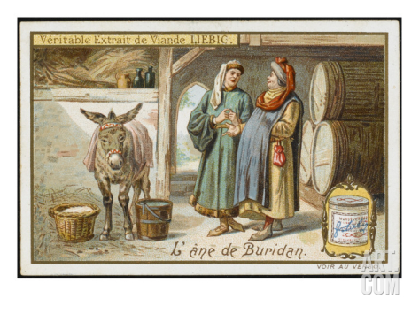
Modeling Choice Procedures
Buridan’s donkey

Slide 135

Modeling Choice Procedures
Political cartoon c. 1900, showing the United States Congress as Buridan's ass (the two hay piles version), hesitating between a Panama route or a Nicaragua route for an Atlantic-Pacific canal

Slide 136
Modeling Choice Procedures
A default bias
The decision maker is characterized by a utility function u and a “bias function” β, which assigns a non-negative number to each alternative
The function u is interpreted as representing the “true” preferences. The number β(x) is interpreted as the bonus attached to x when it is a default alternative

Slide 137
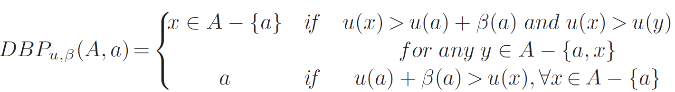
Modeling Choice Procedures
A default bias
Given a extended choice problem (A, a), the procedure denoted by DBP_{u,β} selects:

Slide 138
Modeling Choice Procedures
A default bias
How we characterize the set of extended choice functions that can be described as DBP_{u,β} for some u and β?
We will adopt two assumptions:
The Weak Axiom (WA)
Default Tendency (DT)

Slide 139
Modeling Choice Procedures
A default bias
The Weak Axiom (WA)
We say that an extended choice function c satisfies the Weak Axiom if there are no sets A and B, a, b ∈ A ∩ B, a ≠ b and x, y ∉ {a, b} (x and y are not necessarily distinct) such that:
1. c(A, a) = a and c(B, a) = b or
If a is revealed to be better than b in a choice problem where a is the default, then there cannot be any choice problem in which b is revealed to be better than a when a is the default

Slide 140
Modeling Choice Procedures
A default bias
The Weak Axiom (WA)
We say that an extended choice function c satisfies the Weak Axiom if there are no sets A and B, a, b ∈ A ∩ B, a ≠ b and x, y ∉ {a, b} (x and y are not necessarily distinct) such that:
1. c(A, a) = a and c(B, a) = b or
2. c(A, x) = a and c(B, y) = b
If a is revealed to be better than b in a choice problem where neither a nor b is a default, there cannot be any choice problem in which b is revealed to be better than a when again neither a nor b is the default

Slide 141
Modeling Choice Procedures
A default bias
The Weak Axiom (WA)
WA implies that for every a there is a preference relation ≻_{a} such that c(A, a) is the ≻_{a}-maximal element in A

Slide 142
Modeling Choice Procedures
A default bias
Default Tendency (DT)
If c(A, x) = a, then c(A, a) = a
If the decision maker chooses a from a set A when x ≠ a is the default, he does not change his mind if x is replaced by a as the default alternative
Notes:
Há pessoas que evitam o default de qualquer maneira. Quando algo se torna o default, elas rejeitam.
-Pedro Olmo Stancioli Vaz de Melo

Slide 143
Modeling Choice Procedures
A default bias
Proposition:
An extended choice function c satisfies WA and DT if and only if it is a default-bias procedure (DBP_{u,β})
Proof in the book

Slide 144
Problem
Consider the following choice procedure: a decision maker has a strict ordering ≿ over the set X and assigns to each x ∈ X a natural number class(x) to be interpreted as the “class” of x.
Given a choice problem A, he chooses the best element in A from those belonging to the most common class in A (i.e., the class that appears in A most often). If there is more than one most common class, he picks the best element from the members of A that belong to a most common class with the highest class number.
a. Is this procedure consistent with the “rational man” paradigm?
b. Define the relation: xPy if x is chosen from {x, y}. Show that the relation P is a strict ordering (complete, asymmetric, and transitive)

Slide 145
Problem
a. Is this procedure consistent with the “rational man” paradigm?
No. Let a ≻ b ≻ c ≻ d ≻ e, class(a) = class(b) = class(c) = 1 and class(d) = class(e) =2
C{a, b, c, d, e} = a, but C{a, d, e} = d, thus violating α

Slide 146
Problem
b. Define the relation: xPy if x is chosen from {x, y}. Show that the relation P is a strict ordering (complete, asymmetric, and transitive)
By definition, P is complete and asymmetric. We will see that it is also transitive. That is, if xPy and yPz, then xPz
If xPy and yPz, then [class(x) > class(y) or class(x) = class(y) and x ≿ y], and [class(y) > class(z) or class(y) = class(z) and y ≿ z]
If either class(x) > class(y) or class(y) > class(z), then class(x) > class(z) and C({x,z}) = {x}. Otherwise, class(x) = class(z) and x ≿ z and thus x ∈ C({x,z})

